Slide 1

UECS3213 / UECS3453 Data Mining Topic 2a: Data
Dr. Simon Lau Boung Yew

Slide 2
Course Learning Outcomes
CO1: Identify the key technological foundations of data mining
CO2: Create programming solutions using data mining techniques for given problem
CO3: Evaluate performance of data mining solutions for a given problem
CO4: Construct a data mining project as a team
CO5: Recognize the importance of data mining techniques and its applications in the industry

Slide 3
Outline
What is data?
Attribute and Attribute Value
Types of Data Sets
Structured vs Unstructured Data
Data Processing
Curse of Dimensionality
Similarity and Dissimilarity Measures
Euclidean Distance
Minkowski Distance
Mahalanobis Distance
Simple Matching Coefficient (SMC)
Jaccard (J) Coefficient
Cosine Similarity
Euclidean Density

Slide 4
What is data?
Attributes
Collection of data objects and their attributes
Object is also known as record, point, case, sample, entity, or instance
An attribute is a property or characteristic of an object
Examples: eye color of a person, temperature, etc.
Attribute is also known as variable, field, characteristic, or feature
A collection of attributes describe an object
Tid | Refund | Marital Status |  | Taxable Income
 |  |  |  |  | Cheat
1 | Yes | Single | 125K |  | No
2 | No | Married | 100K |  | No
3 | No | Single | 70K |  | No
4 | Yes | Married | 120K |  | No
5 | No | Divorced | 95K |  | Yes
6 | No | Married | 60K |  | No
7 | Yes | Divorced | 220K |  | No
8 | No | Single | 85K |  | Yes
9 | No | Married | 75K |  | No
10 | No | Single | 90K |  | Yes
Objects
10

Slide 5
Attribute vs Attribute Value
Attribute values are numbers or symbols assigned to an attribute
Same attribute can be mapped to different attribute values
Example: height can be measured in feet or meters
E.g. height = 108cm, 1.71m, 5.9 ft
Different attributes can be mapped to the same set of values
Example: Attribute values for ID and age are integers
E.g. ID = 39, age = 39
But properties of attribute values can be different
ID has no limit but age has a maximum and minimum value

Slide 6
Types of Attributes
Nominal
Examples: ID numbers, eye color, zip codes (discrete)
Ordinal (with order)
Examples: rankings (e.g., taste of potato chips on a scale from 1-10), grades, height in {tall, medium, short}
Interval (with range)
Examples: calendar dates, temperatures in Celsius or Fahrenheit.
Ratio (real number, with decimal places/fractional value)
Examples: temperature in Kelvin, length, time

Slide 7
Properties of Attribute Values
The type of an attribute depends on which of the following properties it possesses:
Distinctness: = ≠ (discrete)
Order: < > (bigger than, smaller than)
Addition: + -
Multiplication: * /
Nominal attribute: distinctness
Ordinal attribute: distinctness & order
Interval attribute: distinctness, order & addition
Ratio attribute: all 4 properties
Notes:
Distinct 分明

Slide 8
Attribute Type | Description | Examples | Operations
Nominal | The values of a nominal attribute are just different names, i.e., nominal attributes provide only enough information to distinguish one object from another. (=, ≠) | zip codes, employee ID numbers, eye color, sex/gender: {male, female} | mode, entropy, contingency correlation
Ordinal | The values of an ordinal attribute provide enough information to order objects. (<, >) | hardness of minerals, {good, better, best}, grades, street numbers | median, percentiles, rank correlation, run test of randomness, sign tests
Interval | For interval attributes, the differences between values are meaningful, i.e., a unit of measurement exists. (+, - ) | calendar dates, temperature in Celsius or Fahrenheit | mean, standard deviation, Pearson's correlation, t and F tests
Ratio | For ratio variables, both differences and ratios are meaningful. (*, /) | temperature in Kelvin, monetary quantities, age, mass, length, electrical current | geometric mean, harmonic mean, percent variation/variance
Notes:
Entropy: lack of order or predictability, chaos, disorganization, randomness
Percentile: https://en.wikipedia.org/wiki/Percentile
A percentile (or a centile) is a measure used in statistics indicating the value below which a given percentage of observations in a group of observations fall.
Contingency: interrelation between two variables
Rank correlation: https://en.wikipedia.org/wiki/Rank_correlation
A rank correlation coefficient measures the degree of similarity between two rankings, and can be used to assess the significance of the relation between them.
Sign test: Sign Test. The Sign test is a non-parametric test that is used to test whether or not two groups are equally sized. ... It is also called the binominal sign test, with p = .5.. The sign test is considered a weaker test, because it tests the pair value below or above the median and it does not measure the pair difference.
https://en.wikipedia.org/wiki/Sign_test
https://www.statisticshowto.datasciencecentral.com/sign-test/
Run test of randomness: The runs test (Bradley, 1968) can be used to decide if a data set is from a random process.
A run is defined as a series of increasing values or a series of decreasing values. The number of increasing, or decreasing, values is the length of the run. In a random data set, the probability that the (I+1)th value is larger or smaller than the Ith value follows a binomial distribution, which forms the basis of the runs test.
https://www.statisticssolutions.com/run-test-of-randomness/
https://www.itl.nist.gov/div898/handbook/eda/section3/eda35d.htm
Pearson correlation coefficient: a measure of the linear correlation between two variables X and Y.
https://en.wikipedia.org/wiki/Pearson_correlation_coefficient
T-test & F-test: https://magoosh.com/statistics/t-test-f-test-fundamentals-test-statistics/
F-test: https://en.wikipedia.org/wiki/F-test
T-test: https://researchbasics.education.uconn.edu/t-test/
Geometric mean: https://en.wikipedia.org/wiki/Geometric_mean
Harmonic mean: https://en.wikipedia.org/wiki/Harmonic_mean
Percent variation:
https://www.dummies.com/software/microsoft-office/excel/calculating-percent-variance-in-excel/
https://www.myaccountingcourse.com/accounting-dictionary/percent-variance

Slide 9
Attribute Level | Transformation | Comments
Nominal | Any permutation of values | If all employee ID numbers were reassigned, would it make any difference?
Ordinal | An order preserving change of values, i.e., new_value = f(old_value) where f is a monotonic function. | An attribute encompassing the notion of good, better best can be represented equally well by the values {1, 2, 3} or by {0.5, 1, 10}.
Interval | new_value = a * old_value + b where a and b are constants | Thus, the Fahrenheit and Celsius temperature scales differ in terms of where their zero value is and the size of a unit (degree).
Ratio | new_value = a * old_value | Length can be measured in meters or feet.

Slide 10
Discrete vs Continuous Values
Discrete Attribute
Has only a finite or countable set of values (permutations)
Examples: zip codes, counts, or the set of keywords in a sentenc
Collection of documents
Often represented as integer variables.
Note: binary attributes (boolean) are a special case of discrete attributes
Continuous Attribute
Has real numbers (continuous) as attribute values
Examples: temperature, height, or weight.
Practically, real values can only be measured and represented using a finite number of digits.
Continuous attributes are typically represented as floating- point variables.

Slide 11
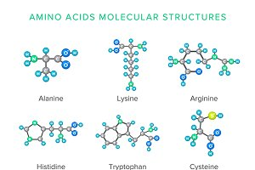
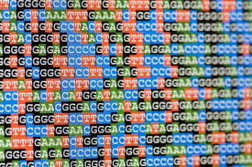
Types of Data Sets
Record
Data Matrix
Document Data
Transaction Data
Graph
World Wide Web
Molecular Structures
Ordered
Spatial Data (e.g. map)
Temporal Data (e.g. time)
Sequential Data (e.g. temperature)
Genetic Sequence Data

Slide 12
Document Data
Each document becomes a `term' vector
Each term is a component (attribute) of the vector
The value of each component is the number of times the corresponding term occurs in the document

Slide 13
Record Data
Data that consists of a collection of records, each of which consists of a fixed set of attributes
Example: table of RDBMD
Tid | Refund | Marital Status | Taxable Income | Cheat
1 | Yes | Single | 125K | No
2 | No | Married | 100K | No
3 | No | Single | 70K | No
4 | Yes | Married | 120K | No
5 | No | Divorced | 95K | Yes
6 | No | Married | 60K | No
7 | Yes | Divorced | 220K | No
8 | No | Single | 85K | Yes
9 | No | Married | 75K | No
10 | No | Single | 90K | Yes
10

Slide 14
Data Matrix
If data objects have the same fixed set of numeric attributes, then the data objects can be thought of as points in a multi-dimensional space, where each dimension represents a distinct attribute (e.g. x, y in a space)
Such data set can be represented by an m by n matrix, where there are m rows, one for each object, and n columns, one for each attribute
Projection of x Load | Projection of y load | Distance | Load | Thickness
10.23 | 5.27 | 15.22 | 2.7 | 1.2
12.65 | 6.25 | 16.22 | 2.2 | 1.1

Slide 15
Transaction Data
A special type of record data, where each record (transaction) involves a set of items.
For example, consider a grocery store. The set of products purchased by a customer during one shopping trip constitute a transaction, while the individual products that were purchased are the items.
TID | Items
1 | Bread, Coke, Milk
2 | Beer, Bread
3 | Beer, Coke, Diaper, Milk
4 | Beer, Bread, Diaper, Milk
5 | Coke, Diaper, Milk

Slide 16



Generic Graph: HTML Links
<a href="papers/papers.html#bbbb"> Data Mining </a>
<li> <a href="papers/papers.html#aaaa"> Graph Partitioning </a>
<li> <a href="papers/papers.html#aaaa">
Parallel Solution of Sparse Linear System of Equations </a>
<li> <a href="papers/papers.html#ffff">
N-Body Computation and Dense Linear System Solvers
2
5
1
2
5

Slide 17
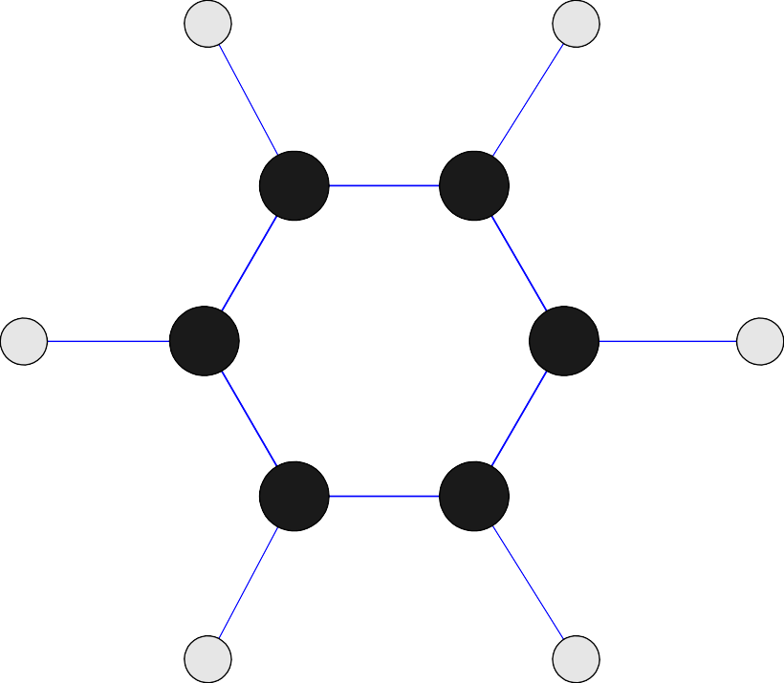
Chemical Data
Benzene Molecule: C₆H₆

Slide 18
Ordered Data
Sequences of transactions

Slide 19
Ordered Data
Genomic sequence data
GGTTCCGCCTTCAGCCCCGCGCC CGCAGGGCCCGCCCCGCGCCGTC GAGAAGGGCCCGCCTGGCGGGCG GGGGGAGGCGGGGCCGCCCGAGC CCAACCGAGTCCGACCAGGTGCC CCCTCTGCTCGGCCTAGACCTGA GCTCATTAGGCGGCAGCGGACAG GCCAAGTAGAACACGCGAAGCGC TGGGCTGCCTGCTGCGACCAGGG

Slide 20
Spatio-Temporal Data
Average Monthly Temperature of land and ocean

Slide 21
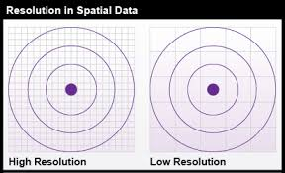
Characteristics of Structure of Data
Dimensionality
Curse of Dimensionality
Sparsity / Scarcity 稀疏
Resolution
Patterns depend on the scale
Notes:
Curse of dimensionality:
https://www.kdnuggets.com/2017/04/must-know-curse-dimensionality.html
https://en.wikipedia.org/wiki/Curse_of_dimensionality
https://alchetron.com/Clustering-high-dimensional-data
This exponential growth in data causes high sparsity in the data set and unnecessarily increases storage space and processing time for the particular modelling algorithm.

Slide 22
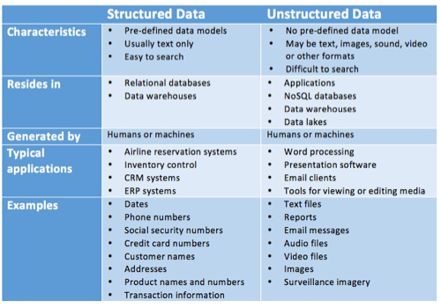
Structured vs Unstructured Data

Slide 23
Data Quality
What are the kinds of data quality problems?
How can we detect problems with the data?
What can we do about these problems?
Examples of data quality problems:
noise and outliers
missing values
duplicate data

Slide 24
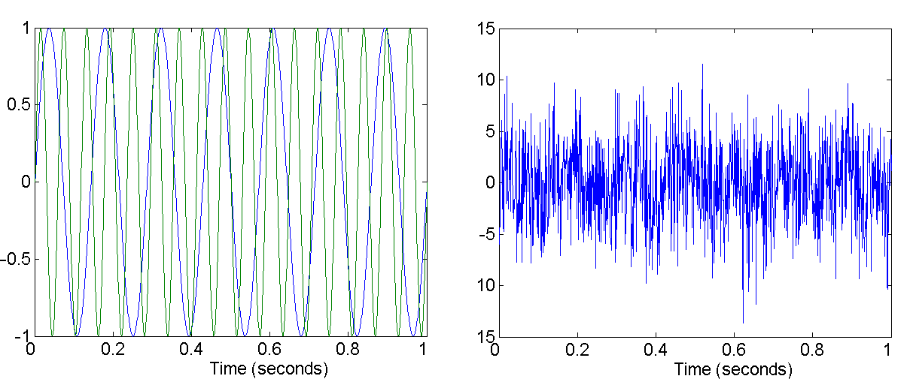
Noise
Noise refers to modification (distortion) of original values
Examples: distortion of a person’s voice when talking on a poor phone and “snow” on television screen.
Two Sine Waves
Two Sine Waves + Noise

Slide 25
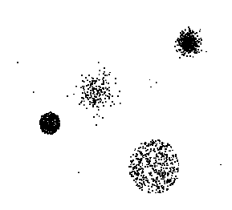
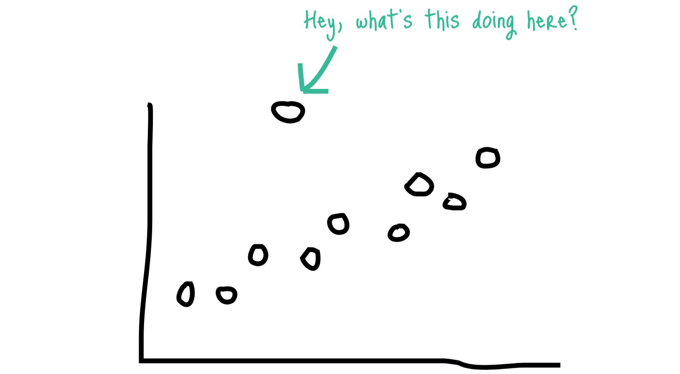




Outliers
Outliers are data objects with characteristics that are considerably different than most of the other data objects in the data set
Outlier ≠ Noise ≠ Error

Slide 26
Missing Values
Reasons for missing values
Information is not collected (e.g., people decline to give their age and weight)
Attributes may not be applicable to all cases (e.g., annual income is not applicable to children)
Handling missing values
Eliminate Data Objects
Estimate Missing Values (interpolate or extrapolate)
Ignore the Missing Value During Analysis
Replace with all possible values (weighted by their probabilities)

Slide 27
Duplicate Data
Data set may include data objects that are duplicates, or almost duplicates of one another
Major issue when merging data from heterogenous sources
Examples:
Same person with multiple email addresses
Data cleaning
Process of dealing with duplicate data issues

Slide 28
Data Processing Tasks
Aggregation
Sampling
Dimensionality reduction
Feature subset selection
Feature creation
Discretization (Quantization) and Binarization
Attribute Transformation

Slide 29
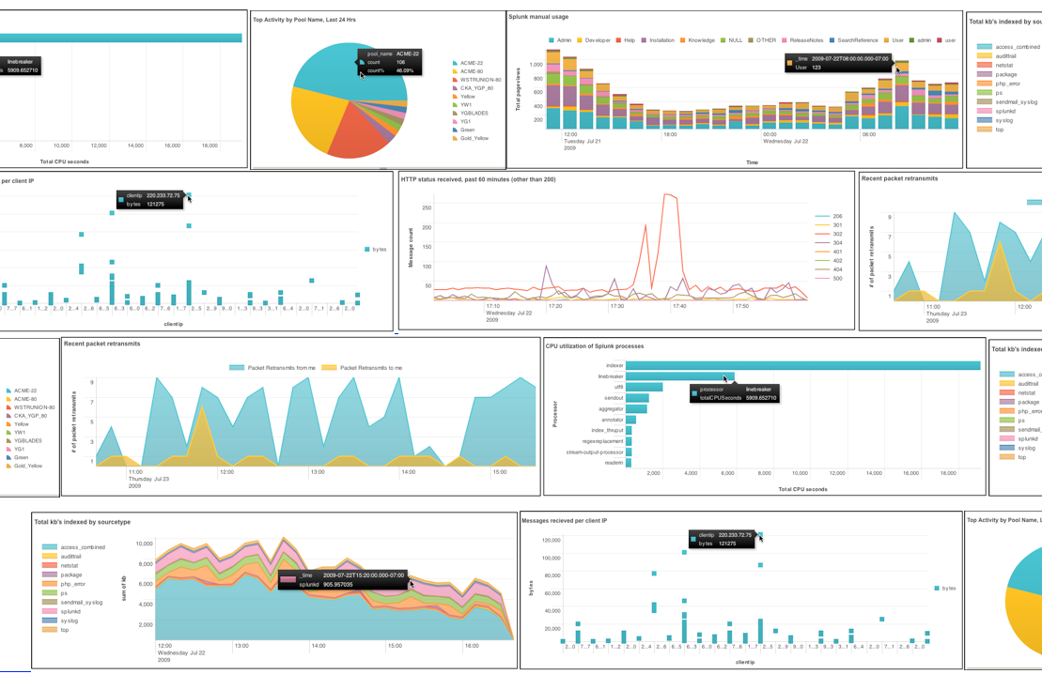
Aggregation
Combining two or more attributes (or objects) into a single attribute (or object): summarize
Purpose
Data reduction
Reduce the number of attributes or objects
Change of scale
Cities aggregated into regions, states, countries, etc.
More “stable” data
Aggregated data tends to have less variability

Slide 30
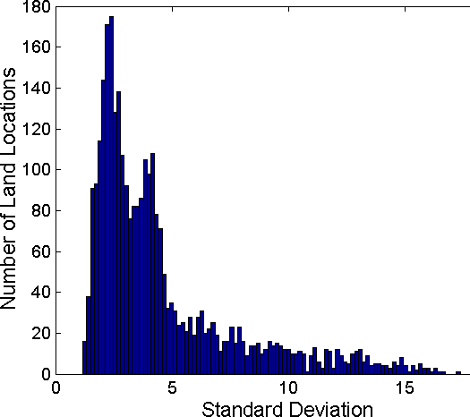
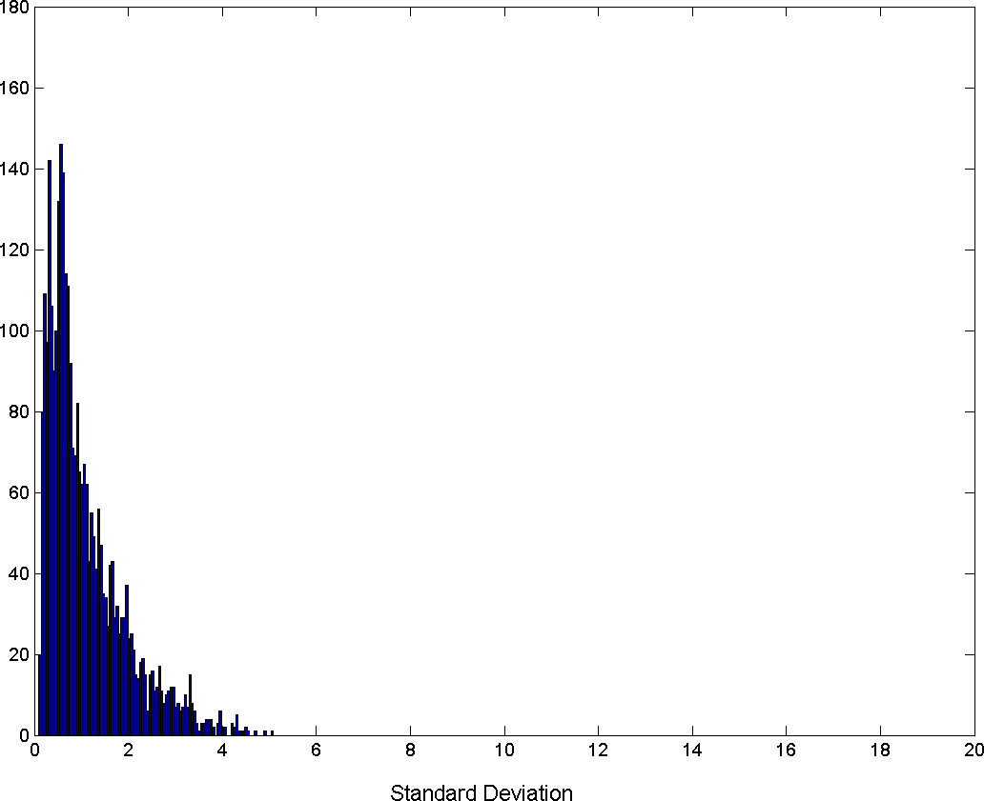
Aggregation
Variation of Precipitation (rainfall) in Australia
Standard Deviation of Average Monthly Precipitation
Standard Deviation of Average Yearly Precipitation
Notes:
Precipitation: atmospheric water vapor that falls under gravity
https://trends.google.com/trends/

Slide 31
Sampling
Sampling is the main technique employed for data selection.
It is often used for both the preliminary investigation of the data and the final data analysis.
Statisticians sample because obtaining the entire set of data of interest (population) is too expensive or time consuming.
Sampling is used in data mining because processing the entire set of data of interest is too expensive or time consuming.

Slide 32
Sampling
The key principle for effective sampling is the following:
Using a sample will work almost as well as using the entire data sets (population), if the sample is representative
A sample is representative if it has approximately the same property of interest as the original set of data

Slide 33
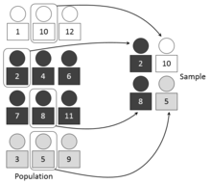
Types of Sampling
Simple random sampling
There is an equal probability of selecting any particular item
Sampling without replacement
As each item is selected, it is removed from the population
Sampling with replacement
Objects are not removed from the population as they are selected for the sample.
In sampling with replacement, the same object can be picked up more than once
Stratified sampling
Split the data into several partitions; then draw random samples from each partition
Statified sampling

Slide 34

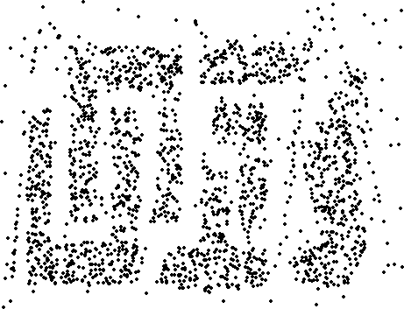
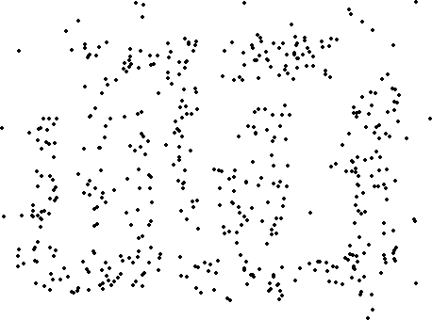
Sample Size
8000 points
2000 Points
500 Points

Slide 35
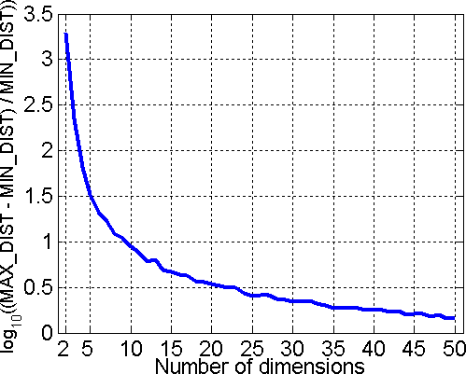
Curse of Dimensionality
When dimensionality increases, data becomes increasingly sparse in the space that it occupies.
Definitions of density and distance between points, which is critical for clustering and outlier detection, become less meaningful.
Randomly generate 500 points
Compute difference between max and min distance between any pair of points

Slide 36
Dimensionality Reduction
Purpose:
Avoid curse of dimensionality
Reduce amount of time and memory required by data mining algorithms
Allow data to be more easily visualized
May help to eliminate irrelevant features or reduce noise
Techniques
Principal Component Analysis (PCA)
Singular Value Decomposition (SVD)
Others: supervised and non-linear techniques
Notes:
https://en.wikipedia.org/wiki/Principal_component_analysis
https://en.wikipedia.org/wiki/Singular_value_decomposition
https://www.youtube.com/watch?v=3uxOyk-SczU
https://www.youtube.com/watch?v=AU_hBML2H1c
https://www.youtube.com/watch?v=yLdOS6xyM_Q
https://www.greycampus.com/opencampus/machine.../dimensionality-reduction-pca

Slide 37
Dimensionality Reduction
Principal component analysis (PCA) is a statistical procedure that uses an orthogonal transformation to convert a set of observations of possibly correlated variables (entities each of which takes on various numerical values) into a set of values of linearly uncorrelated variables called principal components.
Singular Value Decomposition (SVD) is a method of decomposing a matrix into three other matrices: A = USV^{T}
Notes:
https://en.wikipedia.org/wiki/Principal_component_analysis
https://www.cs.cmu.edu/~venkatg/teaching/CStheory-infoage/book-chapter-4.pdf
https://en.wikipedia.org/wiki/Singular_value_decomposition

Slide 38
Feature Subset Selection
Another way to reduce dimensionality of data is by removing
Redundant features
duplicate much or all of the information contained in one or more other attributes
Example: purchase price of a product and the amount of sales tax paid
Irrelevant features
contain no information that is useful for the data mining task at hand
Example: students' ID is often irrelevant to the task of predicting students' GPA

Slide 39
Feature Subset Selection Techniques
Brute-force approach:
Try all possible feature subsets as input to data mining algorithm
Embedded approaches:
Feature selection occurs naturally as part of the data mining algorithm
Filter approaches:
Features are selected before data mining algorithm is run
Wrapper approaches:
Use the data mining algorithm as a black box to find best subset of attributes

Slide 40
Feature Creation
Create new attributes that can capture the important information in a data set much more efficiently than the original attributes
3 general methodologies:
Mapping Data to New Space, e.g. time/space domain to frequency domain
Feature Extraction:
domain-specific: Feature extraction is a dimensionality reduction process, where an initial set of raw variables is reduced to more manageable groups (features) for processing, while still accurately and completely describing the original data set.
Feature Construction
combining features: Feature construction is a process which builds intermediate features from the original descriptors in a dataset. The aim is to build more efficient features for a machine data mining task.
Notes:
Feature extraction: https://en.wikipedia.org/wiki/Feature_extraction
In machine learning, pattern recognition and in image processing, feature extraction starts from an initial set of measured data and builds derived values (features) intended to be informative and non-redundant, facilitating the subsequent learning and generalization steps, and in some cases leading to better human interpretations.
Feature construction: https://www.igi-global.com/dictionary/feature-construction/10959
Feature construction is a process which builds intermediate features from the original descriptors in a dataset. The aim is to build more efficient features for a machine data mining task.
http://www.ar.sanken.osaka-u.ac.jp/~motoda/papers/fdws02.pdf

Slide 41
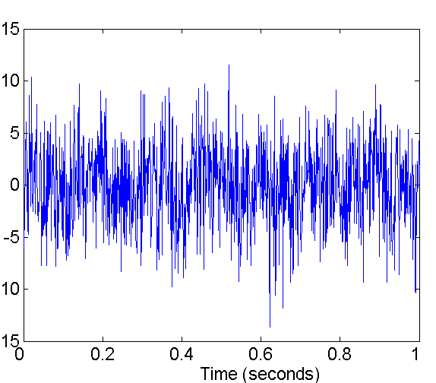
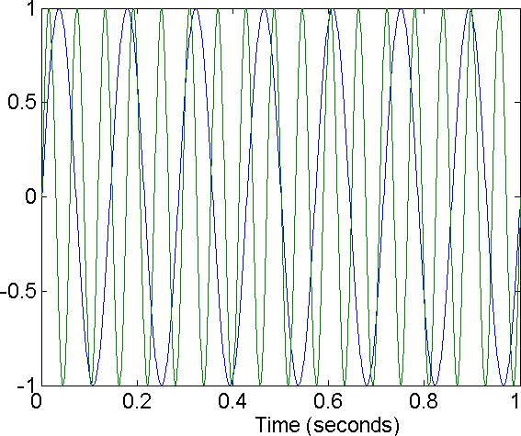
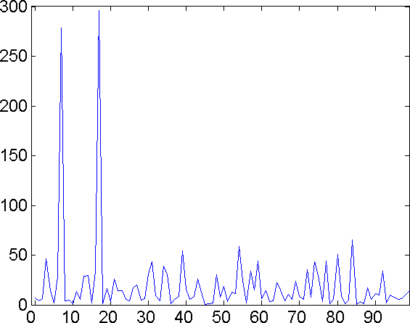
Mapping Data to a New Space
Fourier transform
Wavelet transform
Two Sine Waves
Two Sine Waves + Noise
Frequency
Notes:
Fourier transform: https://en.wikipedia.org/wiki/Fourier_transform
http://www.thefouriertransform.com/
https://betterexplained.com/articles/an-interactive-guide-to-the-fourier-transform/
https://www.youtube.com/watch?v=spUNpyF58BY
https://www.youtube.com/watch?v=vQLH7qTeJRM
https://www.khanacademy.org/partner-content/bjc/2015-challenge/2015-math/v/bjc-fourier-transform
The Fourier Transform is a tool that breaks a waveform (a function or signal) into an alternate representation, characterized by sine and cosines. The Fourier Transform shows that any waveform can be re-written as the sum of sinusoidal functions.
Wavelet transform: http://gwyddion.net/documentation/user-guide-en/wavelet-transform.html
http://gwyddion.net/documentation/user-guide-en/wavelet-transform.html
https://www.youtube.com/watch?v=QX1-xGVFqmw
https://www.youtube.com/watch?v=F7Lg-nFYooU
The wavelet transform is similar to the Fourier transform (or much more to the windowed Fourier transform) with a completely different merit function. The main difference is this: Fourier transform decomposes the signal into sines and cosines, i.e. the functions localized in Fourier space; in contrary the wavelet transform uses functions that are localized in both the real and Fourier space.
Wavelet transforms are a mathematical means for performing signal analysis when signal frequency varies over time. For certain classes of signals and images, wavelet analysis provides more precise information about signal data than other signal analysis techniques.
Applications of Wavelet Transforms. The wavelet transform is a mathematical tool that decomposes a signal into a representation that shows signal details and trends as a function of time. You can use this representation to characterize transient events, reduce noise, compress data, and perform many other operations.

Slide 42
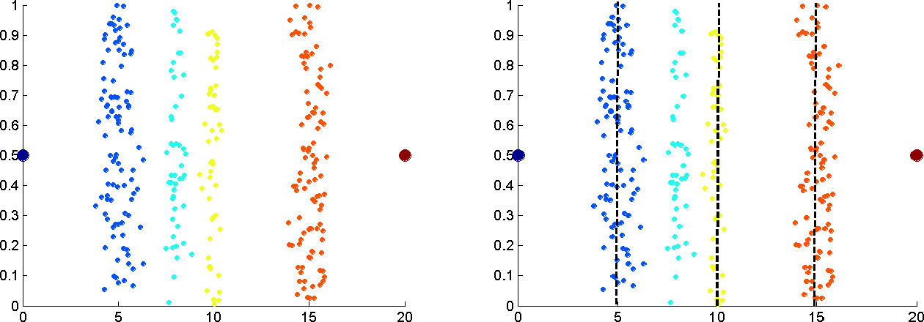
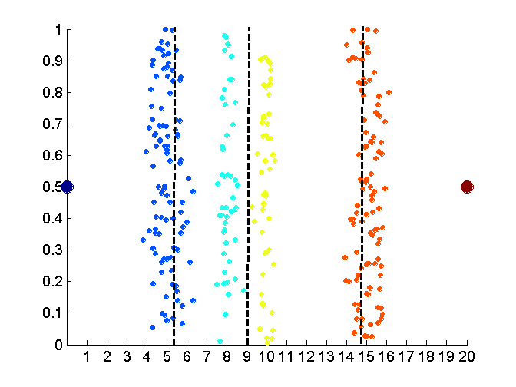
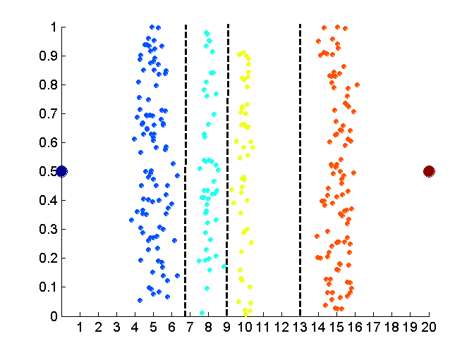
Discretization (quantization) of Continuous Attributes Without Using Class Labels
Data
Equal interval width
Equal frequency
K-means
Notes:
https://en.wikipedia.org/wiki/Discretization_of_continuous_features
discretization refers to the process of converting or partitioning continuous attributes, features or variables to discretized or nominal attributes/features/variables/intervals. This can be useful when creating probability mass functions – formally, in density estimation. It is a form of discretization in general and also of binning, as in making a histogram.
binning: https://en.wikipedia.org/wiki/Data_binning
Data binning (also called Discrete binning or bucketing) is a data pre-processing technique used to reduce the effects of minor observation errors. The original data values which fall in a given small interval, a bin, are replaced by a value representative of that interval, often the central value. It is a form of quantization.

Slide 43
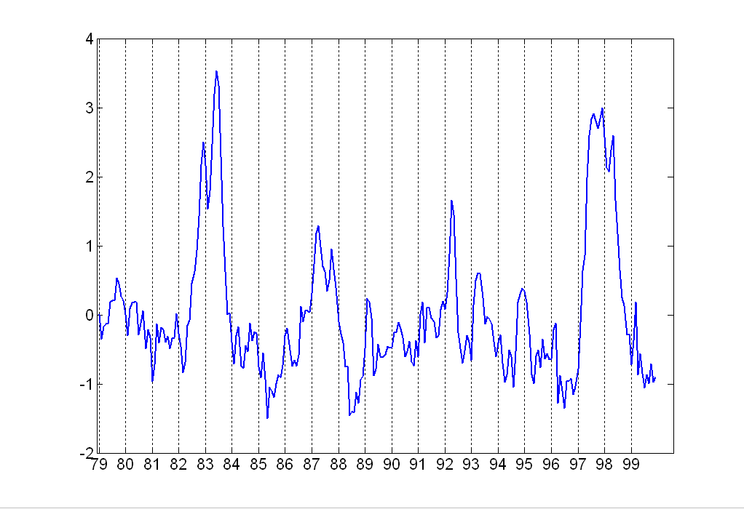
Attribute Transformation (Mapping)
A function (e.g. x^{k}, log(x), e^{x}, |x| etc.) that maps the entire set of values of a given attribute to a new set of replacement values such that each old value can be identified with one of the new values
Standardization and Normalization
Notes:
http://www.dataminingblog.com/standardization-vs-normalization/
Normalization: Normalization, which scales all numeric variables in the range [0,1].
Standardization on your data set. It will then transform it to have zero mean and unit variance

Slide 44
Proximity Measures
When implementing clustering (and also some classification algorithms such as k-NN), it is important to be able to quantify the proximity (similarity / dissimilarity) of objects to one another.
Proximity may be measured in terms of how alike objects are to one another (object similarity) or how unlike they are (object dissimilarity). The term distance measure is often used instead of dissimilarity measure.
Proximity: level of similarity or level of dissimilarity
Notes:
https://degreesofbelief.roryquinn.com/proximity-measures-data-mining

Slide 45
Similarity and Dissimilarity
Similarity
Numerical measure of how alike two data objects are.
Is higher when objects are more alike.
Often falls in the range [0,1]
Proximity refers to a similarity or dissimilarity
Dissimilarity
Numerical measure of how different are two data objects
Lower when objects are more alike
Minimum dissimilarity is often 0
Upper limit varies

Slide 46
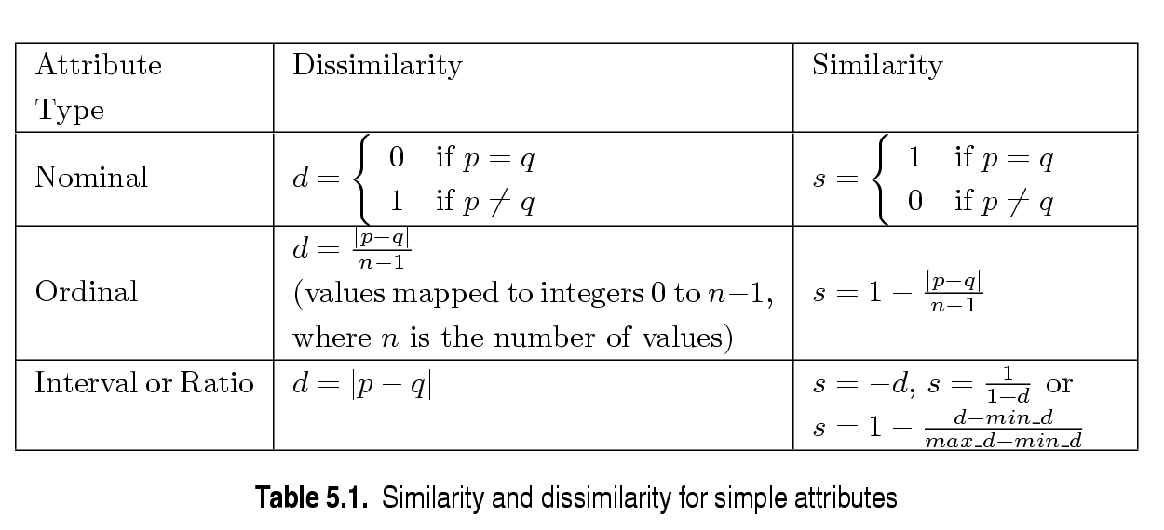
Similarity / Dissimilarity for Simple Attributes
p and q are the attribute values for two data objects.

Slide 47
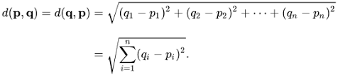
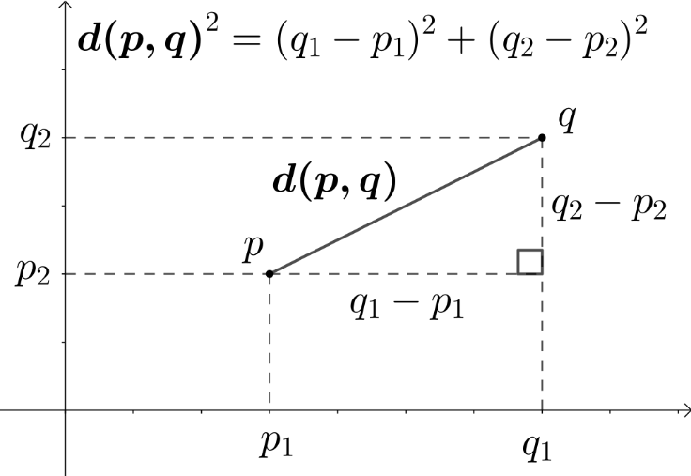
Euclidean Distance
where n is the number of dimensions (attributes) and p_{k} and q_{k} are, respectively, the k^{th} attributes (components) or data objects p and q.
Standardization is necessary, if scales differ.
Notes:
https://en.wikipedia.org/wiki/Euclidean_distance
https://www.youtube.com/watch?v=x6LkcLNDwxY
https://www.youtube.com/watch?v=aBhmeTAuFZI
https://www.youtube.com/watch?v=FQJxCAK4H9A

Slide 48
Euclidean Distance
3
point | x | y
p1 | 0 | 2
p2 | 2 | 0
p3 | 3 | 1
p4 | 5 | 1
2
p1
p3
p4
1
p2
0
0 1
2 3 4
5 6
 | p1 | p2 | p3 | p4
p1 | 0 | 2.828 | 3.162 | 5.099
p2 | 2.828 | 0 | 1.414 | 3.162
p3 | 3.162 | 1.414 | 0 | 2
p4 | 5.099 | 3.162 | 2 | 0
Distance Matrix

Slide 49
Minkowski Distance
Minkowski Distance is a generalization of Euclidean Distance.
where r is a parameter, n is the number of dimensions (attributes) and p_{k} and q_{k} are, respectively, the k^{th} attributes (components) or data objects p and q.
Notes:
https://en.wikipedia.org/wiki/Minkowski_distance

Slide 50
Minkowski Distance: Examples
r = 1. City block (Manhattan, taxicab, L₁ norm) distance.
A common example of this is the Hamming distance, which is just the number of bits that are different between two binary vectors
r = 2. Euclidean distance (L₂ norm)
r → . “supremum” (L_{max} norm, norm) distance.
This is the maximum difference between any component of the vectors
Do not confuse r with n, i.e., all these distances are defined for all numbers of dimensions.
Notes:
L1:
https://en.wikipedia.org/wiki/Taxicab_geometry

Slide 51
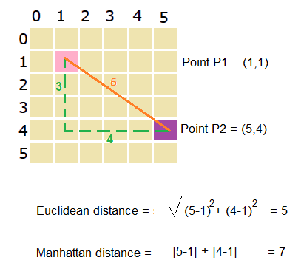
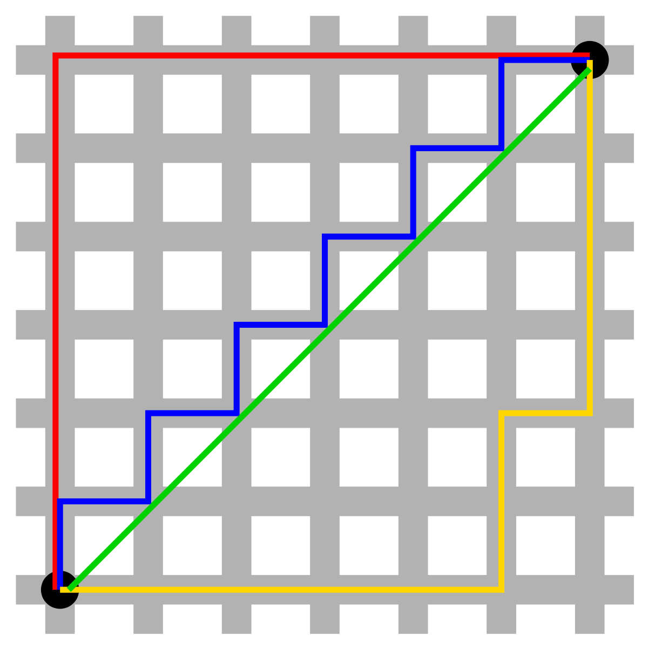
Taxicab / Manhattan Distance
Notes:
According to this interesting paper, Manhattan distance (L1 norm) may be preferable to Euclidean distance (L2 norm) for the case of high dimensional data:
https://bib.dbvis.de/uploadedFiles/155.pdf
The authors of the paper even go a step further and suggest to use Lk norm distances, with a fractional value of k, for very high dimensional data in order to improve the results of distance-based algorithms, like clustering.
https://datascience.stackexchange.com/questions/20075/when-would-one-use-manhattan-distance-as-opposite-to-euclidean-distance

Slide 52
Minkowski Distance
L1 | p1 | p2 | p3 | p4
p1 | 0 | 4 | 4 | 6
p2 | 4 | 0 | 2 | 4
p3 | 4 | 2 | 0 | 2
p4 | 6 | 4 | 2 | 0
point | x | y
p1 | 0 | 2
p2 | 2 | 0
p3 | 3 | 1
p4 | 5 | 1
L2 | p1 | p2 | p3 | p4
p1 | 0 | 2.828 | 3.162 | 5.099
p2 | 2.828 | 0 | 1.414 | 3.162
p3 | 3.162 | 1.414 | 0 | 2
p4 | 5.099 | 3.162 | 2 | 0
L∞ | p1 | p2 | p3 | p4
p1 | 0 | 2 | 3 | 5
p2 | 2 | 0 | 1 | 3
p3 | 3 | 1 | 0 | 2
p4 | 5 | 3 | 2 | 0
Distance Matrix
Notes:
https://helloacm.com/how-to-compute-minkowski-euclidean-and-cityblock-distance-in-c/
https://people.revoledu.com/kardi/tutorial/Similarity/MinkowskiDistance.html

Slide 53
Hamming Distance
The Hamming distance between two strings of equal length is the number of positions at which the corresponding symbols are different.
In other words, it measures the minimum number of substitutions required to change one string into the other.
Notes:
https://en.wikipedia.org/wiki/Hamming_distance
https://sciencing.com/how-to-calculate-hamming-distance-12751770.html

Slide 54
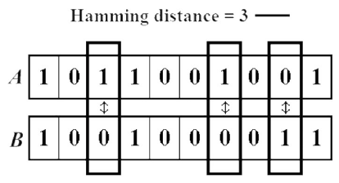
Hamming Distance Example

Slide 55
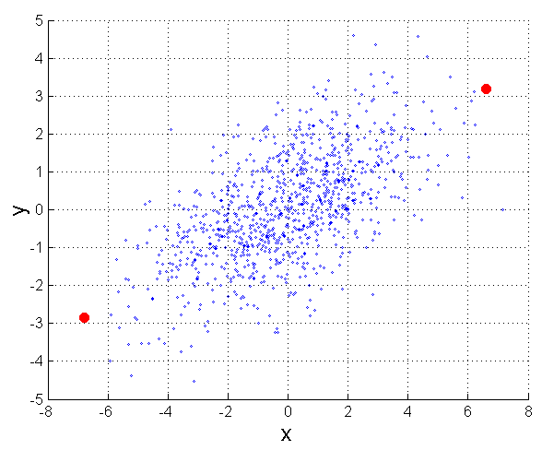
Mahalanobis Distance
The Mahalanobis distance is a measure of the distance between a point P and a distribution D.
It is a multi-dimensional generalization of the idea of measuring how many standard deviations away P is from the mean of D.
This distance is zero if P is at the mean of D, and grows as P moves away from the mean along each principal component axis.

Slide 56
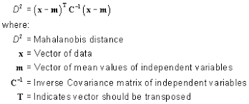
Mahalanobis Distance
The Mahalanobis distance measures the number of standard deviations from P to the mean of D.
The Mahalanobis distance is thus unitless and scale-invariant, and takes into account the correlations of the data set.
Notes:
https://blogs.sas.com/content/iml/2012/02/15/what-is-mahalanobis-distance.html
https://en.wikipedia.org/wiki/Mahalanobis_distance
https://www.statisticshowto.datasciencecentral.com/mahalanobis-distance/
http://www.jennessent.com/arcview/mahalanobis_description.htm
https://www.theinformationlab.co.uk/2017/05/26/mahalanobis-distance/
https://www.youtube.com/watch?v=spNpfmWZBmg
https://www.youtube.com/watch?v=3IdvoI8O9hU
https://www.youtube.com/watch?v=QaKFO0brp_Y
Inverse matrix: https://www.mathsisfun.com/algebra/matrix-inverse.html
covariance: http://ci.columbia.edu/ci/premba_test/c0331/s7/s7_5.html
variance-covariance matrix: https://stattrek.com/matrix-algebra/covariance-matrix.aspx

Slide 57
Mahalanobis Distance Example
For example, suppose we took a single observation from a bivariate population with Variable X and Variable Y, and that our two variables had the following characteristics:
Notes:
http://www.jennessent.com/arcview/mahalanobis_description.htm

Slide 58
Mahalanobis Distance Example
If, in our single observation, X = 410 and Y = 400, we would calculate the Mahalanobis distance for that single value as:
Therefore, our single observation would have a distance of 1.825 standardized units from the mean (mean is at X = 500, Y = 500).
Notes:
https://www.youtube.com/watch?v=QaKFO0brp_Y
https://www.youtube.com/watch?v=ZkC9mRq7Lr8

Slide 59
Common Properties of a Distance
Distances, such as the Euclidean distance, have some well known properties.
d(p, q) ≥ 0 for all p and q and d(p, q) = 0 only if p = q. (Positive definiteness)
d(p, q) = d(q, p) for all p and q. (Symmetry)
d(p, r) ≤ d(p, q) + d(q, r) for all points p, q, and r. (Triangle Inequality)
where d(p, q) is the distance (dissimilarity) between points (data objects), p and q.
A distance that satisfies these properties is a distance metric.

Slide 60
Common Properties of a Similarity
Similarities, also have some well known properties.
s(p, q) = 1 (or maximum similarity) only if p = q.
s(p, q) = s(q, p) for all p and q. (Symmetry)
where s(p, q) is the similarity between points (data objects), p and q.

Slide 61
Similarity between Binary Vectors
Common situation is that objects, p and q, have only binary attributes
Compute similarities using the following quantities
M₀₁ = the number of attributes where p was 0 and q was 1
M₁₀ = the number of attributes where p was 1 and q was 0
M₀₀ = the number of attributes where p was 0 and q was 0
M₁₁ = the number of attributes where p was 1 and q was 1

Slide 62
Similarity between Binary Vectors
Simple Matching Coefficient (SMC)
SMC = number of matches / number of attributes
= (M₁₁ + M₀₀) / (M₀₁ + M₁₀ + M₁₁ + M₀₀)
Jaccard (J) Coefficient
J = number of '11' matches / number of not-both-zero attributes values
= (M₁₁) / (M₀₁ + M₁₀ + M₁₁)
Notes:
https://en.wikipedia.org/wiki/Jaccard_index
https://en.wikipedia.org/wiki/Simple_matching_coefficient

Slide 63
SMC vs Jaccard: Example 1

Slide 64
SMC vs Jaccard: Example 2

Slide 65
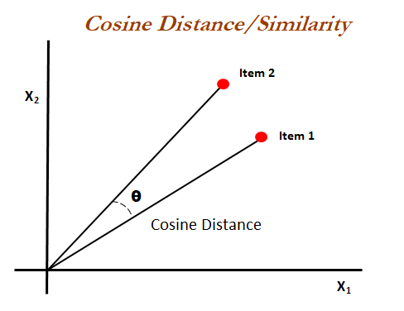
Cosine Similarity
Cosine similarity is a measure of similarity between two non-zero vectors of an inner product space that measures the cosine of the angle between them.
The cosine of 0° is 1 (similar), and it is less than 1 for any angle in the interval [0, π] radians.

Slide 66
Cosine Similarity

Slide 67
Cosine Similarity Example 1
cos(d₁, d₂) = 5 / (6.481+2.45) = 0.3150
Notes:
https://en.wikipedia.org/wiki/Cosine_similarity
http://blog.christianperone.com/2013/09/machine-learning-cosine-similarity-for-vector-space-models-part-iii/

Slide 68
Cosine Similarity Example 2

Slide 69
Extended Jaccard Coefficient (Tanimoto)
Jaccard() --> compute similarities of binary attributes
Tanimoto() --> compute similarities of continuous or count attributes
Reduces to Jaccard for binary attributes
where ||x|| means the length of the vector x
Notes:
https://planetcalc.com/1664/
http://strehl.com/diss/node56.html
http://mines.humanoriented.com/classes/2009/fall/csci568/presentations/08.pdf
http://mines.humanoriented.com/classes/2010/fall/csci568/portfolio_exports/bfindley/similarity.html

Slide 70
Correlation
Correlation measures the linear relationship between objects
Correlation can have a value:
1 is a perfect positive correlation
0 is no correlation (the values don't seem linked at all)
-1 is a perfect negative correlation
Notes:
https://www.mathsisfun.com/data/correlation.html

Slide 71
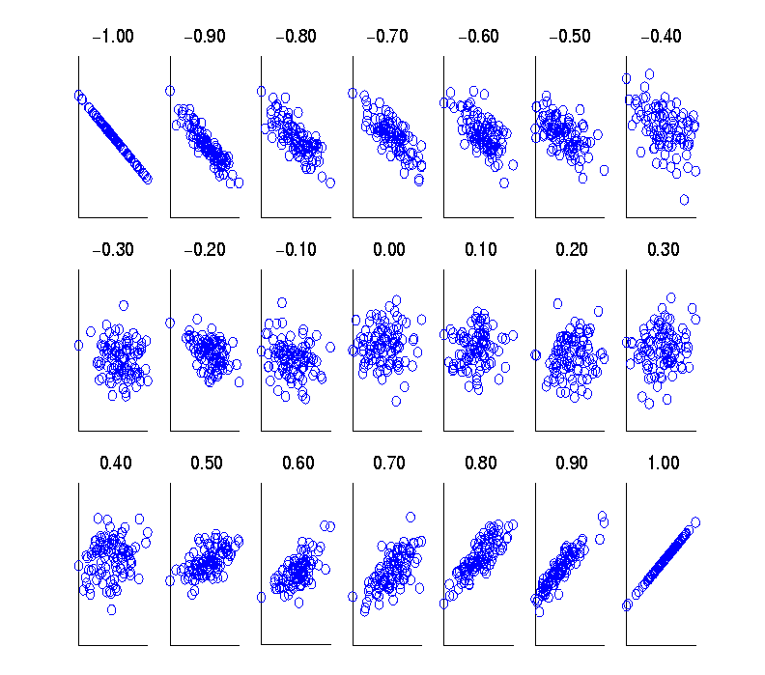
Visually Evaluating Correlation
Scatter plots showing the similarity from –1 to 1.

Slide 72
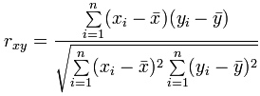
How to calculate Pearson Correlation?
Let us call the two sets of data "x" and "y"
Find the mean of x, and the mean of y
Subtract the mean of x from every x value (call them "a"), do the same for y (call them "b")
Calculate: ab, a² and b² for every value
Sum up ab, sum up a² and sum up b²
Divide the sum of ab by the square root of [(sum of a²) × (sum of b²)]

Slide 73
Calculating Correlation Example: Ice Cream Sales
The local ice cream shop keeps track of how much ice cream they sell versus the temperature on that day, here are their figures for the last 12 days:
Notes:
https://www.mathsisfun.com/data/correlation.html

Slide 74
Exaample: How to calculate Pearson Correlation?

Slide 75
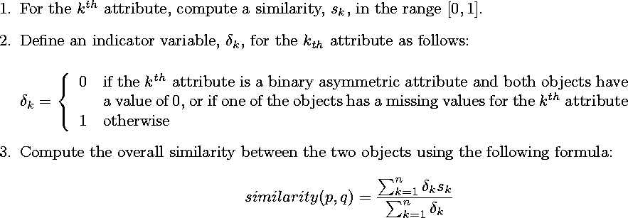
General Approach for Combining Similarities
Sometimes attributes are of many different types (binary, nominal, ordinal etc.), but an overall similarity is needed.

Slide 76


Using Weight to Combine Similarities
May not want to treat all attributes the same.
Use weights w_{k} which are between 0 and 1 and sum to 1.

Slide 77
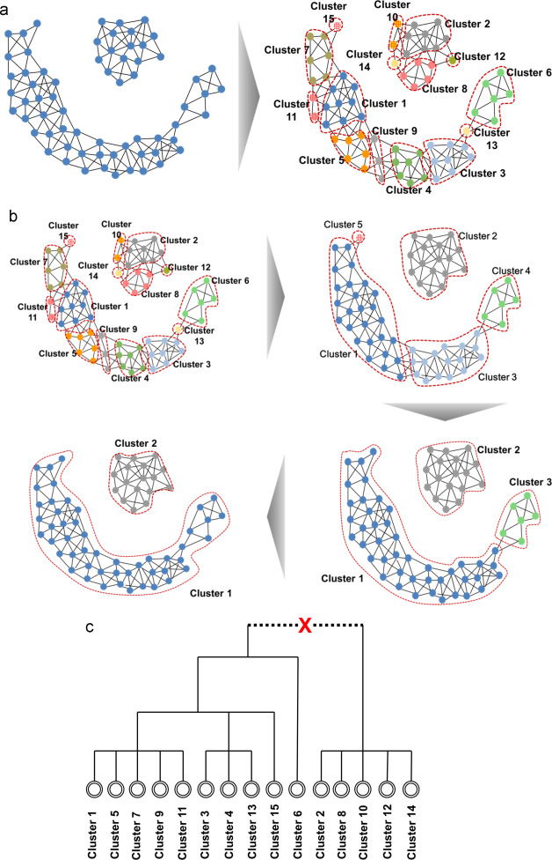
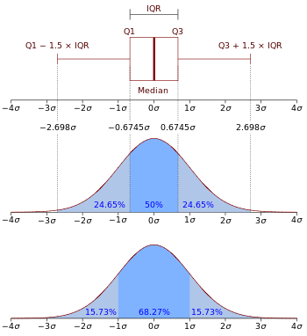
Density
Density-based clustering requires a notion of density
Examples:
Euclidean density = number of points per unit volume
Probability density
Graph-based density
Notes:
https://mathinsight.org/probability_density_function_idea

Slide 78
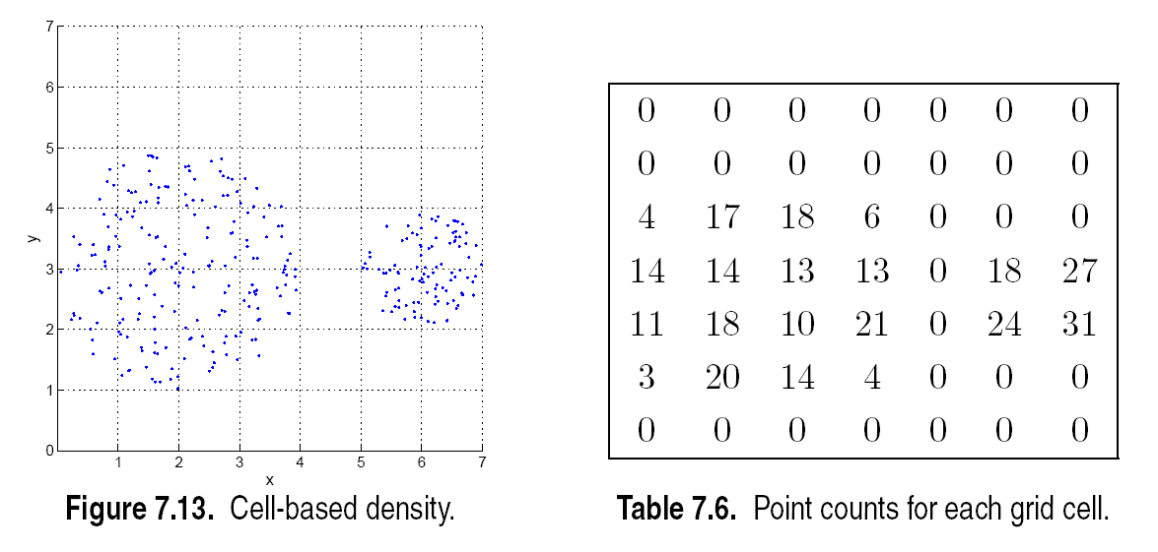
Euclidean Density: Cell-based
Simplest approach is to divide region into a number of rectangular cells of equal volume and define density as # of points the cell

Slide 79
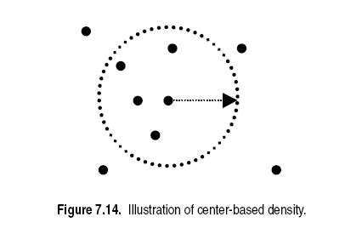
Euclidean Density: Center-based
Euclidean density is the number of points within a specified radius of the point

Slide 80
Conclusion
In this chapter, we have learned
various types of data
how the different types of data differs from each other
similiarity and distance (dissimilarity) measures for data

Slide 81
Main References
Harrington, P (2012). Machine Learning in Action. Manning Publications.
Richert, W. and Coelho, L.P. (2013). Building Machine Learning Systems with Python. Packt Publishing.
Witten, I.H, Franck, E, and Hall, M. A. (2011). Data Mining: Practical Machine Learning Tools and Techniques. (3rd ed.). Morgan Kaufmann.
Pang-Ning Tan, Michael Steinbach, Anuj Karpatne, Vipin Kumar (2018). Introduction to Data Mining (2nd Edition), Pearson

Slide 82
Other References
J. Grus (2015). Data Science from Scratch: First Principles with Python. O'Reilly Media.
C. C. Aggarwal. (2015). Data Mining: The Textbook. Springer
Richert, W. and Coelho, L.P. (2013). Building Machine Learning Systems with Python. Packt Publishing.
Russel M.A. (2013). Mining the Social Web: Data Mining Facebook, Twitter, LinkedIn, Google+, GitHub, and More. (2nd Ed). O’Reilly Media.

